Slide 1


APreliminary Usability Study of a Virtual Reality-Based Rehabilitation System Using IMU Sensors.
Ranfery Josua Peregrina Morales, Victor Alejandro Ovalle Pantaleón, Leticia Neira-Tovar and HomeroMorales Carrillo
Presented by: Hemish Briones
Universidad Autónoma de Nuevo León, San Nicolás de los Garza, Nuevo León México
Facultad de Ingeniería Mecánica y Eléctrica, Laboratorio de Realidad Virtual e Inmersiva

Slide 2

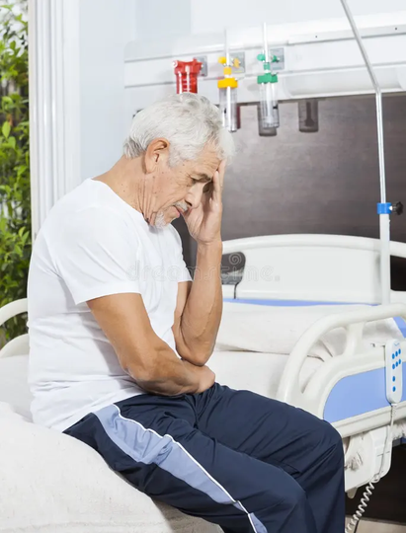
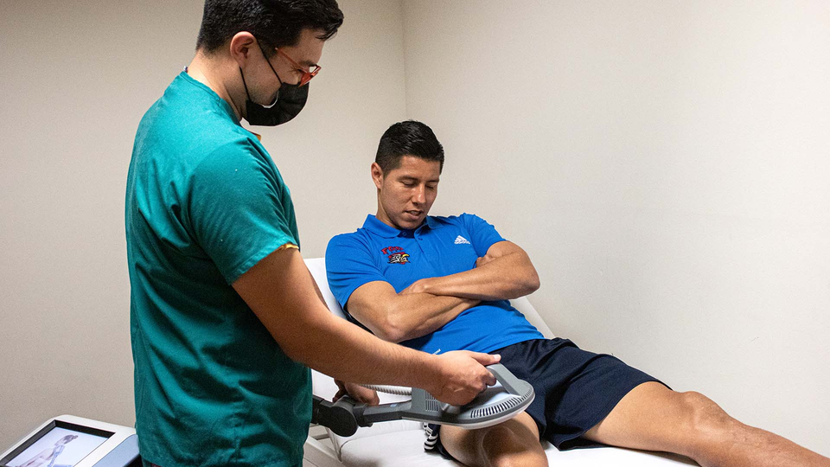
Physical rehabilitation and the recovery process
Sadness
Boredom
Loss of motivation

Slide 3
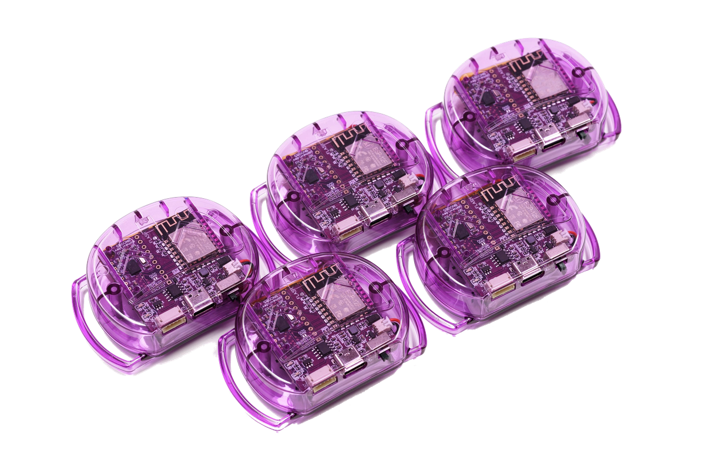
Our Objective
IMU SENSORTS
UNITY 3D (Game Engine)
The open-source software SlimeVR Server was used to receive and process raw sensor data. To enable real-time data streaming into the Unity3D environment, the Virtual Motion Capture (VMC) protocol and Open Sound Control (OSC) were activated within the SlimeVR Server.

Slide 4
System Architecture
The system includes a set of interactive scenes that structure the user’s experience, beginning with an instruction screen, followed by a main menu and two independent exercise modules focused on knee and shoulder rehabilitation
SlimeVR sensors
SlimeVR server
OSC/VMC
Unity3D
Avatar VRM

Slide 5
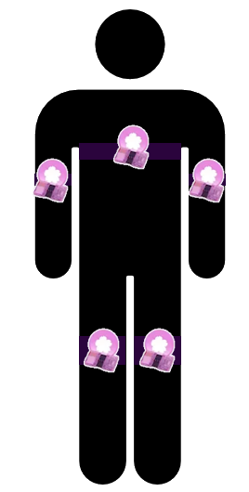
Placement of sensors
(Body image with 5 targets (1 per sensor, chest, legs, arms)
The sensor configuration consisted of five identical SlimeVR inertial sensors, placed on the following body segments: chest, both arms (above the elbow), and both legs (above the knee).

Slide 6
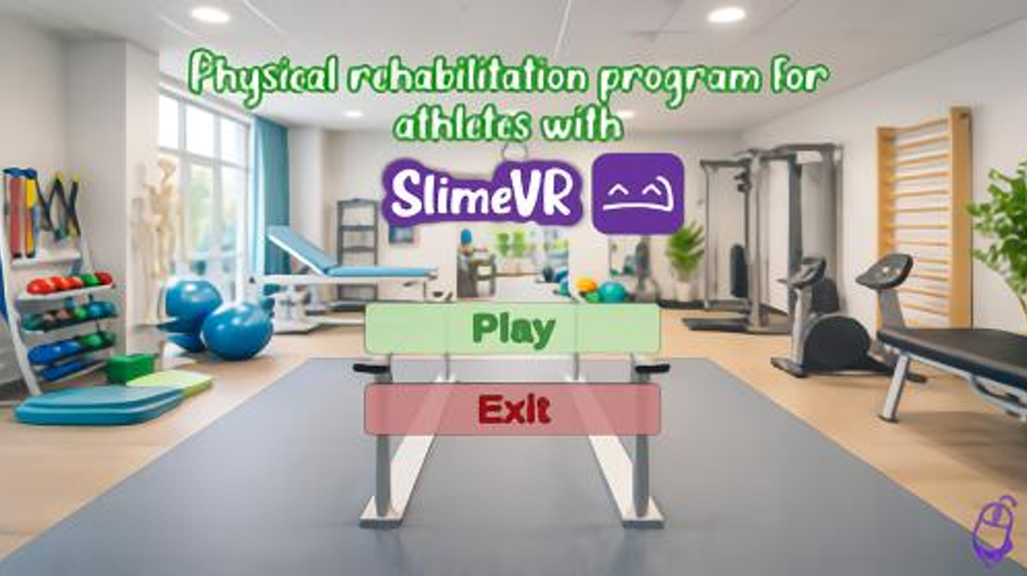
Menu Scene

Slide 7
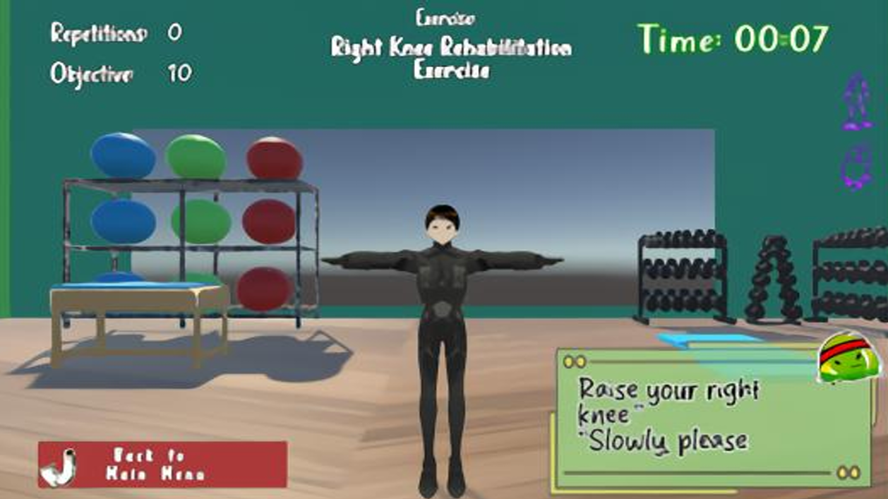
Knee excersice scene

Slide 8

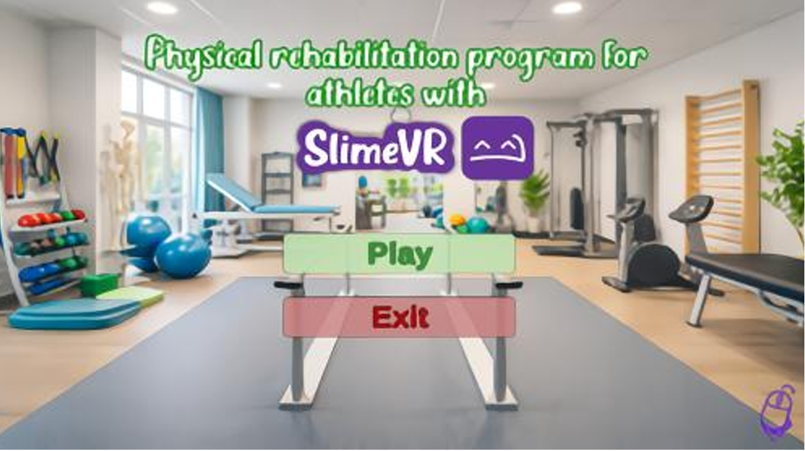
Shoulder Rehabiltation Excersise

Slide 9
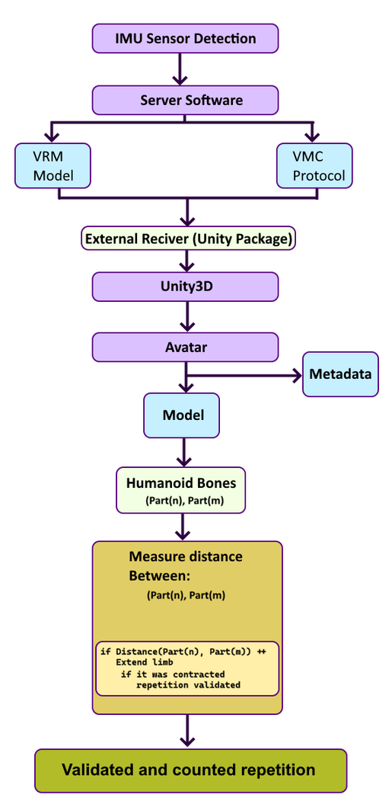
Detection of repetitions
Each repetition of movement is measured by tracking the distance between parts of the avatar's body.
And each movement of the avatar is captured in real time by the sensors.

Slide 10
Experimental Evaluation
Testing sessions were conducted individually with each participant in a controlled indoor environment. Initially, a brief explanation of the system and the purpose of the exercise session was provided on how to use the system and then performed both exercise modules (knee and shoulder).
The total duration of each session ranged between 5 and 10 minutes. The instructor attended one of the evaluation sessions to assess the program’s performance.

Slide 11
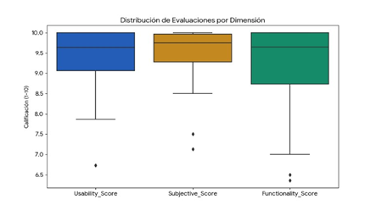
Results
.
Participants rated the clarity of the exercise objectives with an average score of 9.33, while the ease of understanding the required movements reached an average of 9.60. Similarly, the visual organization of the interface received an average score of 9.56, suggesting that the system’s design is intuitive for user interaction.

Slide 12
Limitations
Not was real patients
It does not measure clinical effectiveness
Lack of correct biomechanical detection
.
It is important to emphasize that this study evaluates usability, user perception, and system functionality, rather than clinical rehabilitation outcomes.
One of the lowest-rated items was ”error detection” (8.67/10). The current implementation only detects whether a repetition was completed based on distance.

Slide 13
Presentation by Hemish Briones.
Q&A Session

